Slide 1

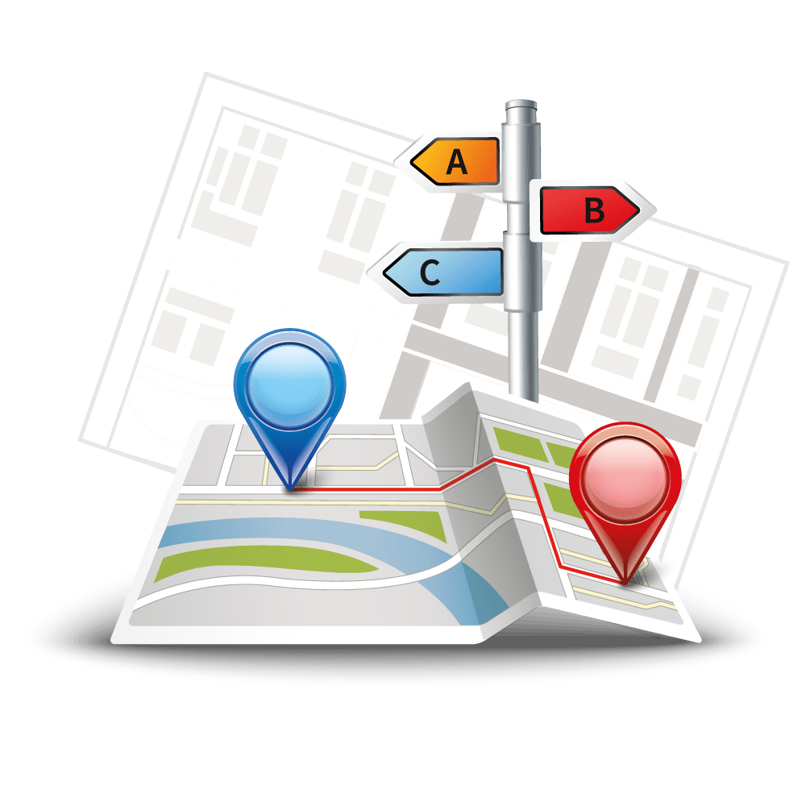

Slide 2
About today…
React
Router
Navigation

Slide 3
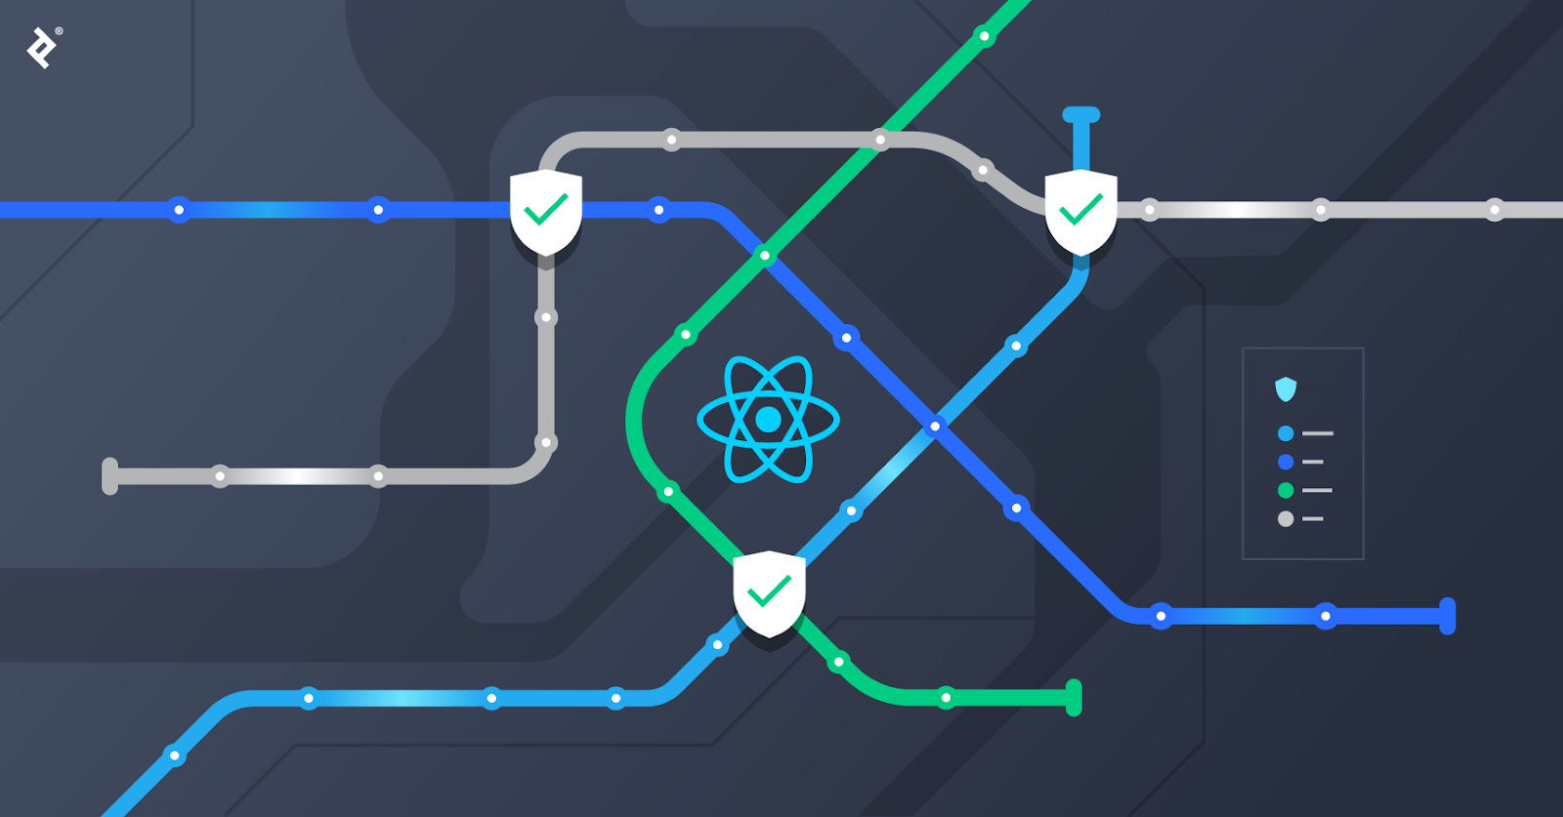
React
Router and Navigation

Slide 4
Intro to React Router
Definition
React Router is a library for routing in React applications
Purpose
Enables navigation between different components, changing URLs without a page reload
Features
Declarative routing
Dynamic routing based on URL parameters
Nested routes for complex layouts

Slide 5
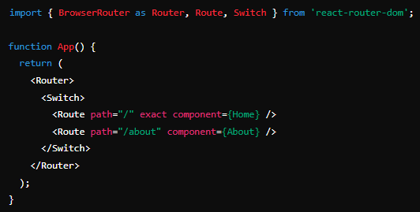
Setting Up React Router
Installation
Basic Setup

Slide 6
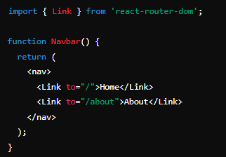
Basic Routing and Navigation
Defining Routes
Use the Route component to define a route
Use exact to specify an exact match
Navigation Links
Use the Link component for navigation

Slide 7
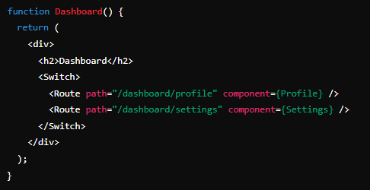
Nested Routes
Purpose
Allows creating a nested structure of routes
Example

Slide 8
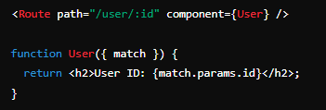
Route Parameters
Dynamic Routing
Use route parameters for dynamic routing
Example

Slide 9
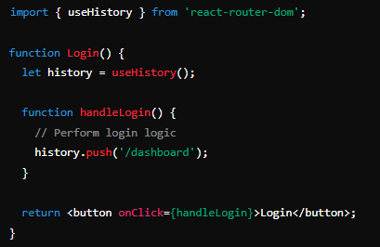
Programmatic Navigation
Using useHistory

Slide 10
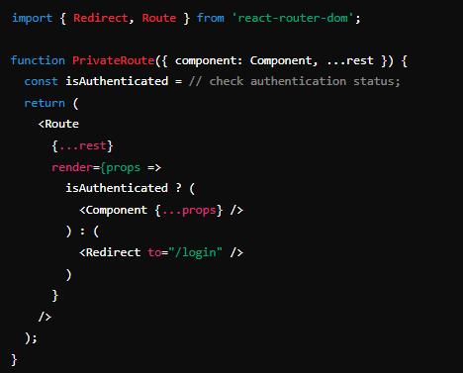
Protected Routes
Purpose
Restrict access to certain routes based on authentication
Implementation

Slide 11

What is the main purpose of React Router in a React application?
React Router enables navigation between different components and changes URLs without reloading the page
How do you install React Router in your project?
You can install React Router using the command npm install react-router-dom
What is the exact prop used for in a Route component?
The exact prop ensures that the route matches exactly with the specified path
How can you create navigation links in React Router?
By using the Link component from react-router-dom.
What are nested routes in React Router?
Nested routes allow creating a nested structure of routes within another route

Slide 12

Task
Create a React application with basic navigation, nested routes

Slide 13


